Slide 1
AngularJS
Modules, Filter, Services

Slide 2
AngularJS Modules
An AngularJS module defines an application.
The module is a container for the different parts of an application.
Controllers always belong to a module.
A module in AngularJS is a container of the different parts of an application such as controller, service, filters, directives etc.
This application module can contain other modules, controllers, filters, etc.

Slide 3
Creating a Module
A module is created by using the AngularJS function angular.module
<div ng-app="myApp">...</div>
<script>
var app = angular.module("myApp", []);
</script>
The "myApp" parameter refers to an HTML element in which the application will run.

Slide 4
Example: Create Application Module
<!DOCTYPE html>
<html>
<head>
<script src="~/Scripts/angular.js"></script>
</head>
<body ng-app="myApp"> @* HTML content *@
<script>
var myApp = angular.module('myApp', []);
</script>
</body>
</html>

Slide 5
Example Explanation
The angular.module() method creates an application module, where the first parameter is a module name which is same as specified by ng-app directive.
The second parameter is an array of other dependent modules [].
In the above example we are passing an empty array because there is no dependency.
Note:
The angular.module() method returns specified module object if no dependency is specified.
Therefore, specify an empty array even if the current module is not dependent on other module.

Slide 6
Example:Create Controller Module
In the above example, we have created a controller named "myController" using myApp.controller() method.
Here, myApp is an object of a module, and controller() method creates a controller inside "myApp" module.
So, "myController" will not become a global function.

Slide 7
Modules in Separate Files

Slide 8

AngularJS Filters
AngularJS Filters allow us to format the data to display on UI without changing original format.
Filters can be used with an expression or directives using pipe | sign.
Angular includes various filters to format data of different data types. The following table lists important filters.

Slide 9
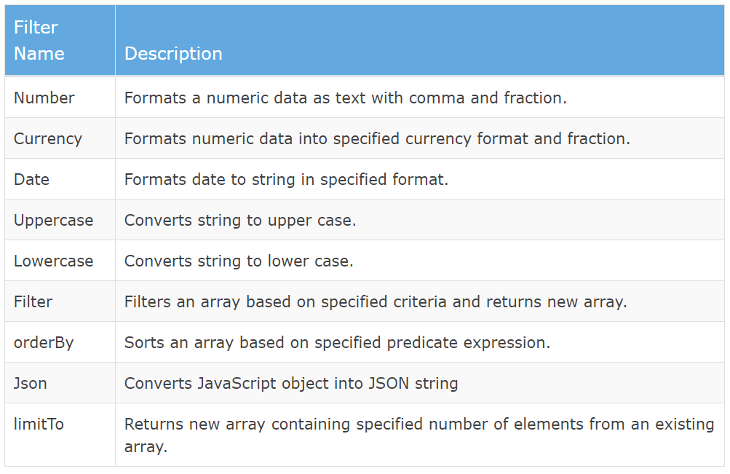

Slide 10

Number Filter
A number filter formats numeric data as text with specified fraction size.
If a specified expression does not return a valid number then number filter displays an empty string.
The example demonstrates how to use number filter with number expression or a model property.

Slide 11
Currency Filter
The currency filter formats a number value as a currency.
When no currency symbol is provided, default symbol for current locale is used.
Example:
In the example, we have applied currency filter to person.salary, which is a numeric property. It can be displayed with different currency symbols and fractions.

Slide 12

Date filter
Formats date to string based on the specified format.
The date can be a date object, milliseconds, or a datetime string like "2016-01-05T09:05:05.035Z"
Uppercase/lowercase filter
The uppercase filter converts the string to upper case and lowercase filter converts the string to lower case.

Slide 13

Filter
Filter selects items from an array based on the specified criteria and returns a new array.
orderBy filter
The orderBy filter sorts an array based on specified expression predicate.

Slide 14
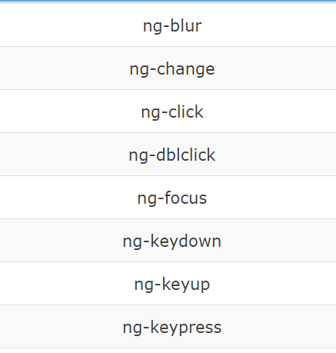
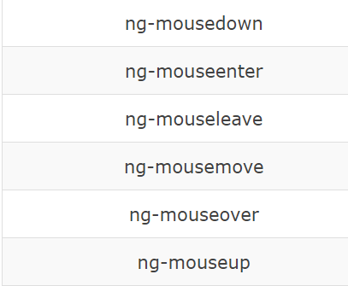
AngularJS Events
AngularJS includes certain directives which can be used to provide custom behavior on various DOM events, such as click, dblclick, mouseenter etc.
The following table lists AngularJS event directives.

Slide 15
ng-click
The ng-click directive is used to provide event handler for click event.
In the example, ng-click directive is used to call a DisplayMessage() function with the 'password' parameter when a user clicks a button.
A 'password' is a model property defined using ng-model directive in the input box.
The DisplayMessage() function is attached to a $scope object in myController, so it will be accessible from button click as button comes under myController.
The $window service is used to display an alert.

Slide 16
Mouse Events
Mouse events occur when the cursor moves over an element, in this order:
ng-mouseover
ng-mouseenter
ng-mousemove
ng-mouseleave
when a mouse button is clicked on an element, in this order:
ng-mousedown
ng-mouseup
ng-click
Notes:
he mouseover event triggers when the mouse pointer enters the div element, and its child elements.
The mouseenter event is only triggered when the mouse pointer enters the div element.
The onmousemove event triggers every time the mouse pointer is moved over the div element.

Slide 17
Toggle, True/False
If you want to show a section of HTML code when a button is clicked, and hide when the button is clicked again, like a dropdown menu, make the button behave like a toggle switch:
Example
The showMe variable starts out as the Boolean value false.
The myFunc function sets the showMe variable to the opposite of what it is, by using the ! (not) operator.

Slide 18
$event Object
You can pass the $event object as an argument when calling the function.
The $event object contains the browser's event object:

Slide 19
AngularJS Services
In AngularJS you can make your own service, or use one of the many built-in services.
In AngularJS, a service is a function, or object, that is available for, and limited to, your AngularJS application.
AngularJS has about 30 built-in services. One of them is the $location service.
The $location service has methods which return information about the location of the current web page:
Note that the $location service is passed in to the controller as an argument. In order to use the service in the controller, it must be defined as a dependency.

Slide 20
Why use Services?
For many services, like the $location service, it seems like you could use objects that are already in the DOM, like the window.location object, and you could, but it would have some limitations, at least for your AngularJS application.
AngularJS constantly supervises your application, and for it to handle changes and events properly, AngularJS prefers that you use the $location service instead of the window.location object.

Slide 21
AngularJS Services
AngularJS services are JavaScript functions for specific tasks, which can be reused throughout the application.
AngularJS includes services for different purposes. For example, $http service can be used to send an AJAX request to the remote server.
AngularJS also allows you to create custom service for your application.

Slide 22
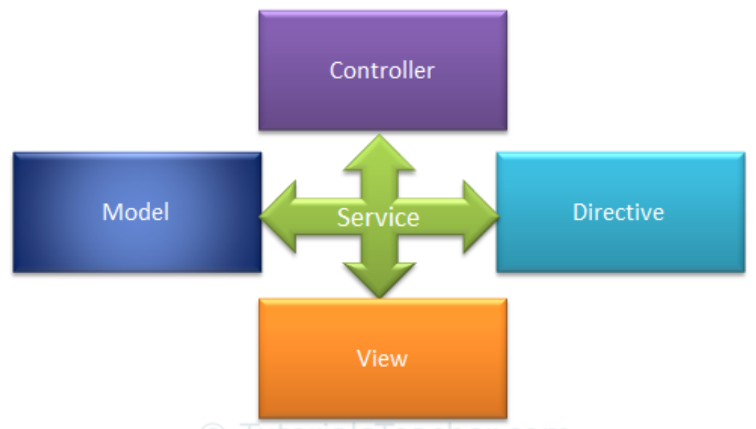
Most AngularJS services interact with the controller, model or custom directives.
Some services interact with view (UI) also for UI specific tasks.

Slide 23
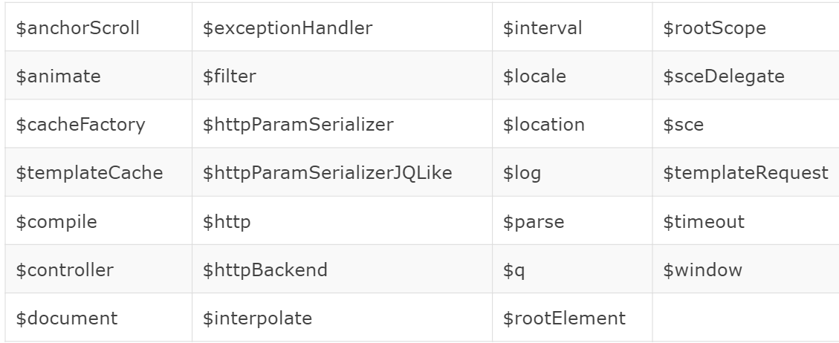
The following table lists all the built-in AngularJS services.
Notes:
$anchorScroll: When called, it scrolls to the element related to the specified hash or (if omitted) to the current value of $location.hash(),
<div id="scrollArea" ng-controller="ScrollController"> <a ng-click="gotoBottom()">Go to bottom</a> <a id="bottom"></a> You're at the bottom! </div>

Slide 24
Continue
All the Angular services are lazy instantiated and singleton.
It means AngularJS framework instantiates a service when an application component depends on it.
Also, all the components share the same instance of a service.
Notes:
AngularJS Services are Always Singletons
This means that, once AngularJS constructs a service object, the same instance is reused throughout your app.
There are never ever two service instances.
This makes them great candidates to share application data across multiple components.
For example, after a successful login, you'll need to store the login status where the status can be retrieved in all other components.
In this scenario, you can store the status in a service and then, whenever you need to read the value, you can just inject it into your controller/service and check it.

Slide 25
AngularJS Services are Always Singletons
This means that, once AngularJS constructs a service object, the same instance is reused throughout your app.
There are never ever two service instances.
This makes them great candidates to share application data across multiple components.
For example, after a successful login, you'll need to store the login status where the status can be retrieved in all other components.
In this scenario, you can store the status in a service and then, whenever you need to read the value, you can just inject it into your controller/service and check it.

Slide 26
The $http Service
The $http service is one of the most common used services in AngularJS applications.
The service makes a request to the server, and lets your application handle the response.
The $http service is used to send or receive data from the remote server using browser's XMLHttpRequest or JSONP.
$http is a service as an object. It includes following shortcut methods.

Slide 27
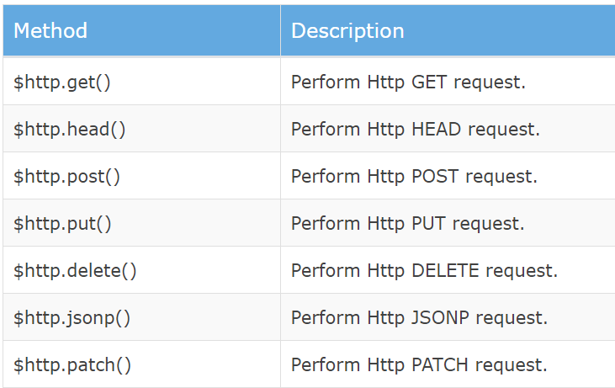
Continue
Notes:
The HEAD method
The HEAD method is used to ask only for information about a document, not for the document itself. HEAD is much faster than GET, as a much smaller amount of data is transferred. It's often used by clients who use caching, to see if the document has changed since it was last accessed. If it was not, then the local copy can be reused, otherwise the updated version must be retrieved with a GET. The metainformation contained in the HTTP headers in response to a HEAD request should be identical to the information sent in response to a GET request. This method can be used for obtaining metainformation about the resource identified by the request URI without transferring the data itself. This method is often used for testing hypertext links for validity, accessibility, and recent modification.

Slide 28
What are Promises?
A promise represents the eventual result of an operation.
You can use a promise to specify what to do when an operation eventually succeeds or fails.
A Promise is a an object with a then method. The then method has two(optional) parameters of type function. The signature of the then method looks like this
promise.then(onSucess, onFailure);
The onSucess function is called whenever the asynchronous tasks ends successfully and the onFailure function is called if the tasks fails to execute. For each promise only one of the functions can be called. The task either succeeds or it fails; no other outcome is possible.

Slide 29
Example
var promise = $http.get("/api/my/name");
promise.success(function(name) {
console.log("Your name is: " + name);
});
promise.error(function(response, status) {
console.log("The request failed with response " + response + " and status code " + status); });

Slide 30
Example
$http.get("/api/my/name")
.success(function(name) {
console.log("Your name is: " + name);
})
.error(function(response, status) {
console.log("The request failed with response " + response + " and status code " + status);
});

Slide 31
Example
$http.get("/api/my/name")
.then(
/* success */
function(response) {
console.log("Your name is: " +
response.data);
},
/* failure */
function(error)
{
console.log("The request failed: " + error);
});

Slide 32
$http.get()
$http.get() method sends http GET request to the remote server and retrieves the data.
$http.get(url)
The example demonstrates the use of $http service in a controller to send HTTP GET request.

Slide 33
Example Explanation
In the example, 'myController' controller includes $http parameter, so that it can be used to send GET request.
AngularJS automatically injects $scope parameter at runtime.
The success() method registers a callback method which is called when a request completes successfully.
The error() method registers a callback method which is called when a request fails and returns an error.
The onSuccess() method above, attaches the response data to the $scope.
The onError() method attaches status property to the $scope.

Slide 34
$http.post
The $http.post() method sends Http POST request to the remote server to submit and retrieve the data.
$http.post(url, dataToSubmit);

Slide 35
$http()
You can use construction function of $http service to perform http request
Thus, you can use $http service to send AJAX request to the remote server.

Slide 36
$log Service
AngularJs includes logging service $log, which logs the messages to the browser's console.
The $log service includes different methods to log the error, information, warning or debug information.
controller function includes $log parameter which will be supplied by AngularJS framework.

Slide 37
$interval Service
AngularJS includes $interval service which performs the same task as setInterval() method in JavaScript.
The $interval is a wrapper for setInterval() method, so that it will be easy to override, remove.
The $interval service executes the specified function on every specified milliseconds duration.
The example demonstrates $interval service that displays a counter on each 1000 milliseconds.
Notes:
In the above example, $interval service calls increaseCounter() function on every 1000 milliseconds.
The increaseCounter() function increases the $scope.counter property by 1. Thus, counter increases on every milliseconds.

Slide 38
The $timeout Service
The $timeout service is AngularJS' version of the window .setTimeout function.

Slide 39
$window Service
AngularJs includes $window service which refers to the browser window object.
In the JavaScript, window is a global object which includes many built-in methods like alert(), prompt() etc.
The $window service is a wrapper around window object, so that it will be easy to override, remove.

Slide 40
Create Your Own Service
To create your own service, connect your service to the module:
Use a Custom Service Inside a Filter
Once you have created a service, and connected it to your application, you can use the service in any controller, directive, filter, or even inside other services.
To use the service inside a filter, add it as a dependency when defining the filter:

Slide 41
AngularJS Forms
Forms in AngularJS provides data-binding and validation of input controls.
Input Controls
Input controls are the HTML input elements:
input elements
select elements
button elements
textarea elements

Slide 42
AngularJS Routing
We can build Single Page Application (SPA) with AngularJS.
It is a web app that loads a single HTML page and dynamically updates that page as the user interacts with the web app.
AngularJS supports SPA using routing module ngRoute.
This routing module acts based on the url.
When a user requests a specific url, the routing engine captures that url and renders the view based on the defined routing rules.

Slide 43
AngularJS Routing
The ngRoute module helps your application to become a Single Page Application.
What is Routing in AngularJS?
If you want to navigate to different pages in your application, but you also want the application to be a SPA (Single Page Application), with no page reloading, you can use the ngRoute module.
The ngRoute module routes your application to different pages without reloading the entire application.

Slide 44
Steps
To make your applications ready for routing, you must include the AngularJS Route module:
<script src="https://ajax.googleapis.com/ajax/libs/angularjs/1.6.9/angular-route.js"></script>
2. Then you must add the ngRoute as a dependency in the application module:
var app = angular.module("myApp", ["ngRoute"]);

Slide 45
3. Now your application has access to the route module, which provides
the $routeProvider.
Use the $routeProvider to configure different routes in your application:
app.config(function($routeProvider) { $routeProvider .when("/", { templateUrl : "main.htm" }) .when("/red", { templateUrl : "red.htm" }) .when("/green", { templateUrl : "green.htm" }) .when("/blue", { templateUrl : "blue.htm" }); });

Slide 46
4. Your application needs a container to put the content provided by
the routing. This container is the ng-view directive.
Applications can only have one ng-view directive, and this will be the placeholder for all views provided by the route.

Slide 47
Advantage of AngularJS
Dependency Injection: Dependency Injection specifies a design pattern in which components are given their dependencies instead of hard coding them within the component.
Two way data binding: AngularJS creates a two way data-binding between the select element and the orderProp model. orderProp is then used as the input for the orderBy filter.
Model View Controller: In Angular JS, it is very easy to develop application in a clean MVC way. You just have to split your application code into MVC components i.e. Model, View and the Controller.
Directives, filters, modules, routes etc.

Slide 48
Features of Angularjs
It gives rich Developer control.
It provides reusable components.
It provides capability to create Single Page Application in a very clean and maintainable way.
It provides data binding capability to HTML thus giving user a rich and responsive experience.
With AngularJS, developer write less code and get more functionality.
In AngularJS, views are pure html pages, and controllers written in JavaScript do the business processing.

Slide 49
Advantage of Angularjs
AngularJS is a framework of JavaScript. It improve the properties of Html elements. Some advantage of of angularjs are;
Less Code: It help to write less code. Using angularjs developers can achieve more functionality with writing less code.
Testable: It make your application testable. AngularJS code is unit testable.
It increase the level of abstraction.
It provides reusable components.
Using this you can design more responsive web pages.
It work well with other Libraries.
It help to make and design a big applications.
AngularJS support most of all new web browser and all mobiles OS.
In AngularJS view are pure html code and controller are written in JavaScript to achieve business logic.

Slide 50
Dis-advantage of Angularjs
Not Secure: It is a framework of JavaScript not a server side programming. Only server side programs provides security, server side authentication and authorization provides security for application.
Depends on User: If any user disable JavaScript in their own browser then nothing will be apply on your application related to JavaScript and AngularJS, Only basic Html page will display.

